Slide 1
ATMOS

Slide 2
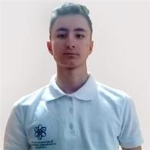
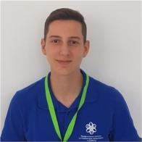
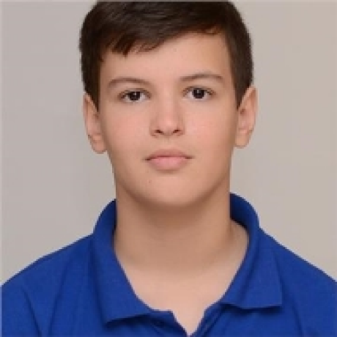
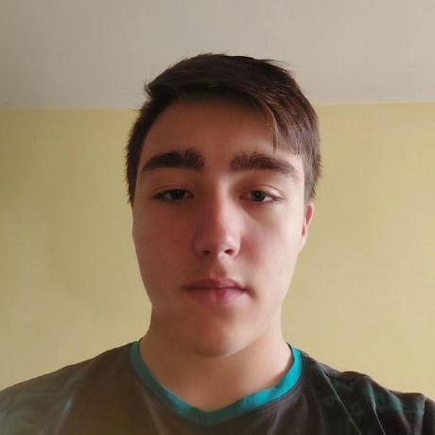
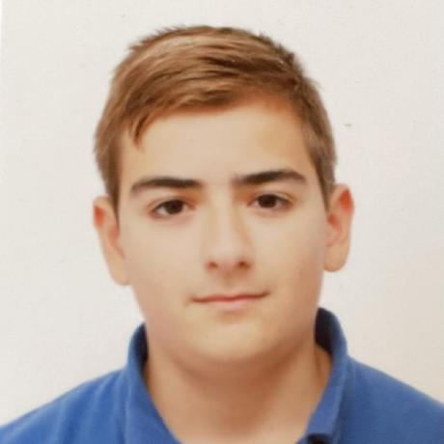
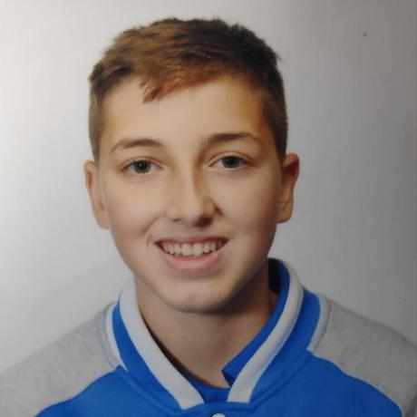
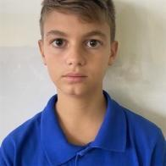
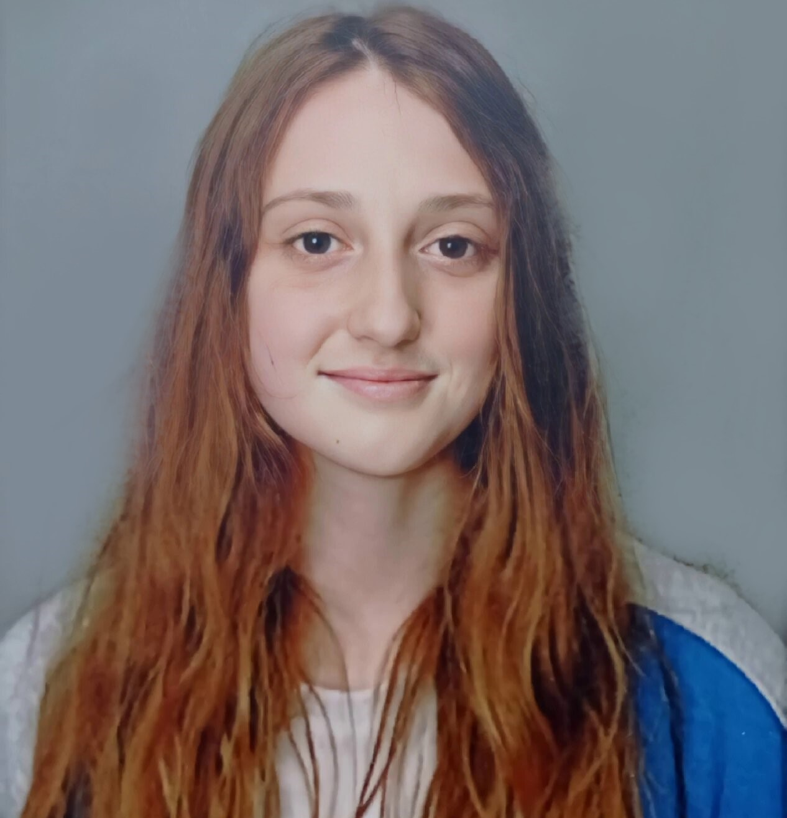
Our team
Boris Savov
Nikola Peshev
Valeri Ivanov
Stefan Hristov
Boris Savov
Nikola Peshev
Valeri Ivanov
Stefan Hristov
Scrum Trainer/Backend
Scrum Trainer
Frontend Developer
Backend Developer
Maxim Marinov
Dimitar Byandov
Vicho Vichev
Mariya Koleva
Dimitar Byandov
Frontend Developer
Designer
QA Engineer/Docs
QA Engineer/Docs

Slide 3
Stages of development
# 2
Our idea
# 1 Forming our team
# 4
Presenting
# 3
Working on the project

Slide 4























The programs we used

Slide 5
Let’s jump to the project!
Let’s jump to our project!

